Slide 1
Fine-Tuning a Compact Instruction-Tuned Language Model for Retail E-Commerce Customer-Support Conversational AI
Harish Chandra
Master's in CS: Artificial Intelligence and Machine Learning, Woolf University
31 May 2026

Slide 2
Problem & Research Question
• E-commerce support is high-volume and repetitive: orders, refunds, cancellations, returns, delivery, payments.
• Customers expect instant, 24/7 answers - costly to staff with humans alone.
• Large LLMs work but are expensive; out of reach for many small/mid-sized retailers.
• Research question:
– Can flan-t5-small be fine-tuned on retail support data to give accurate, relevant answers on a single free-tier GPU?

Slide 3
Why Retail E-Commerce?
• Online retail is a multi-trillion-dollar, fast-growing sector; support volume scales with sales.
• Chatbot market ~$7.76B (2024) -> ~$27.29B (2030); customer service is the largest application.
• A small set of recurring intents dominates the workload - highly automatable.
• Business value: lower cost-per-contact, instant 24/7 responses, consistency, scalability.

Slide 4
Literature & Research Gap
• Foundations: Transformer (Vaswani 2017), T5 (Raffel 2020), instruction tuning / FLAN (Chung 2022).
• Applied: fine-tuned transformers & generative assistants for support (Nandi 2024; Khennouche 2023).
• Gap 1: low-resource, compact models for retail support are under-reported.
• Gap 2: most work isolates intent classification, not end-to-end response generation.
• Contribution: reproducible single-GPU end-to-end study with honest failure analysis.

Slide 5
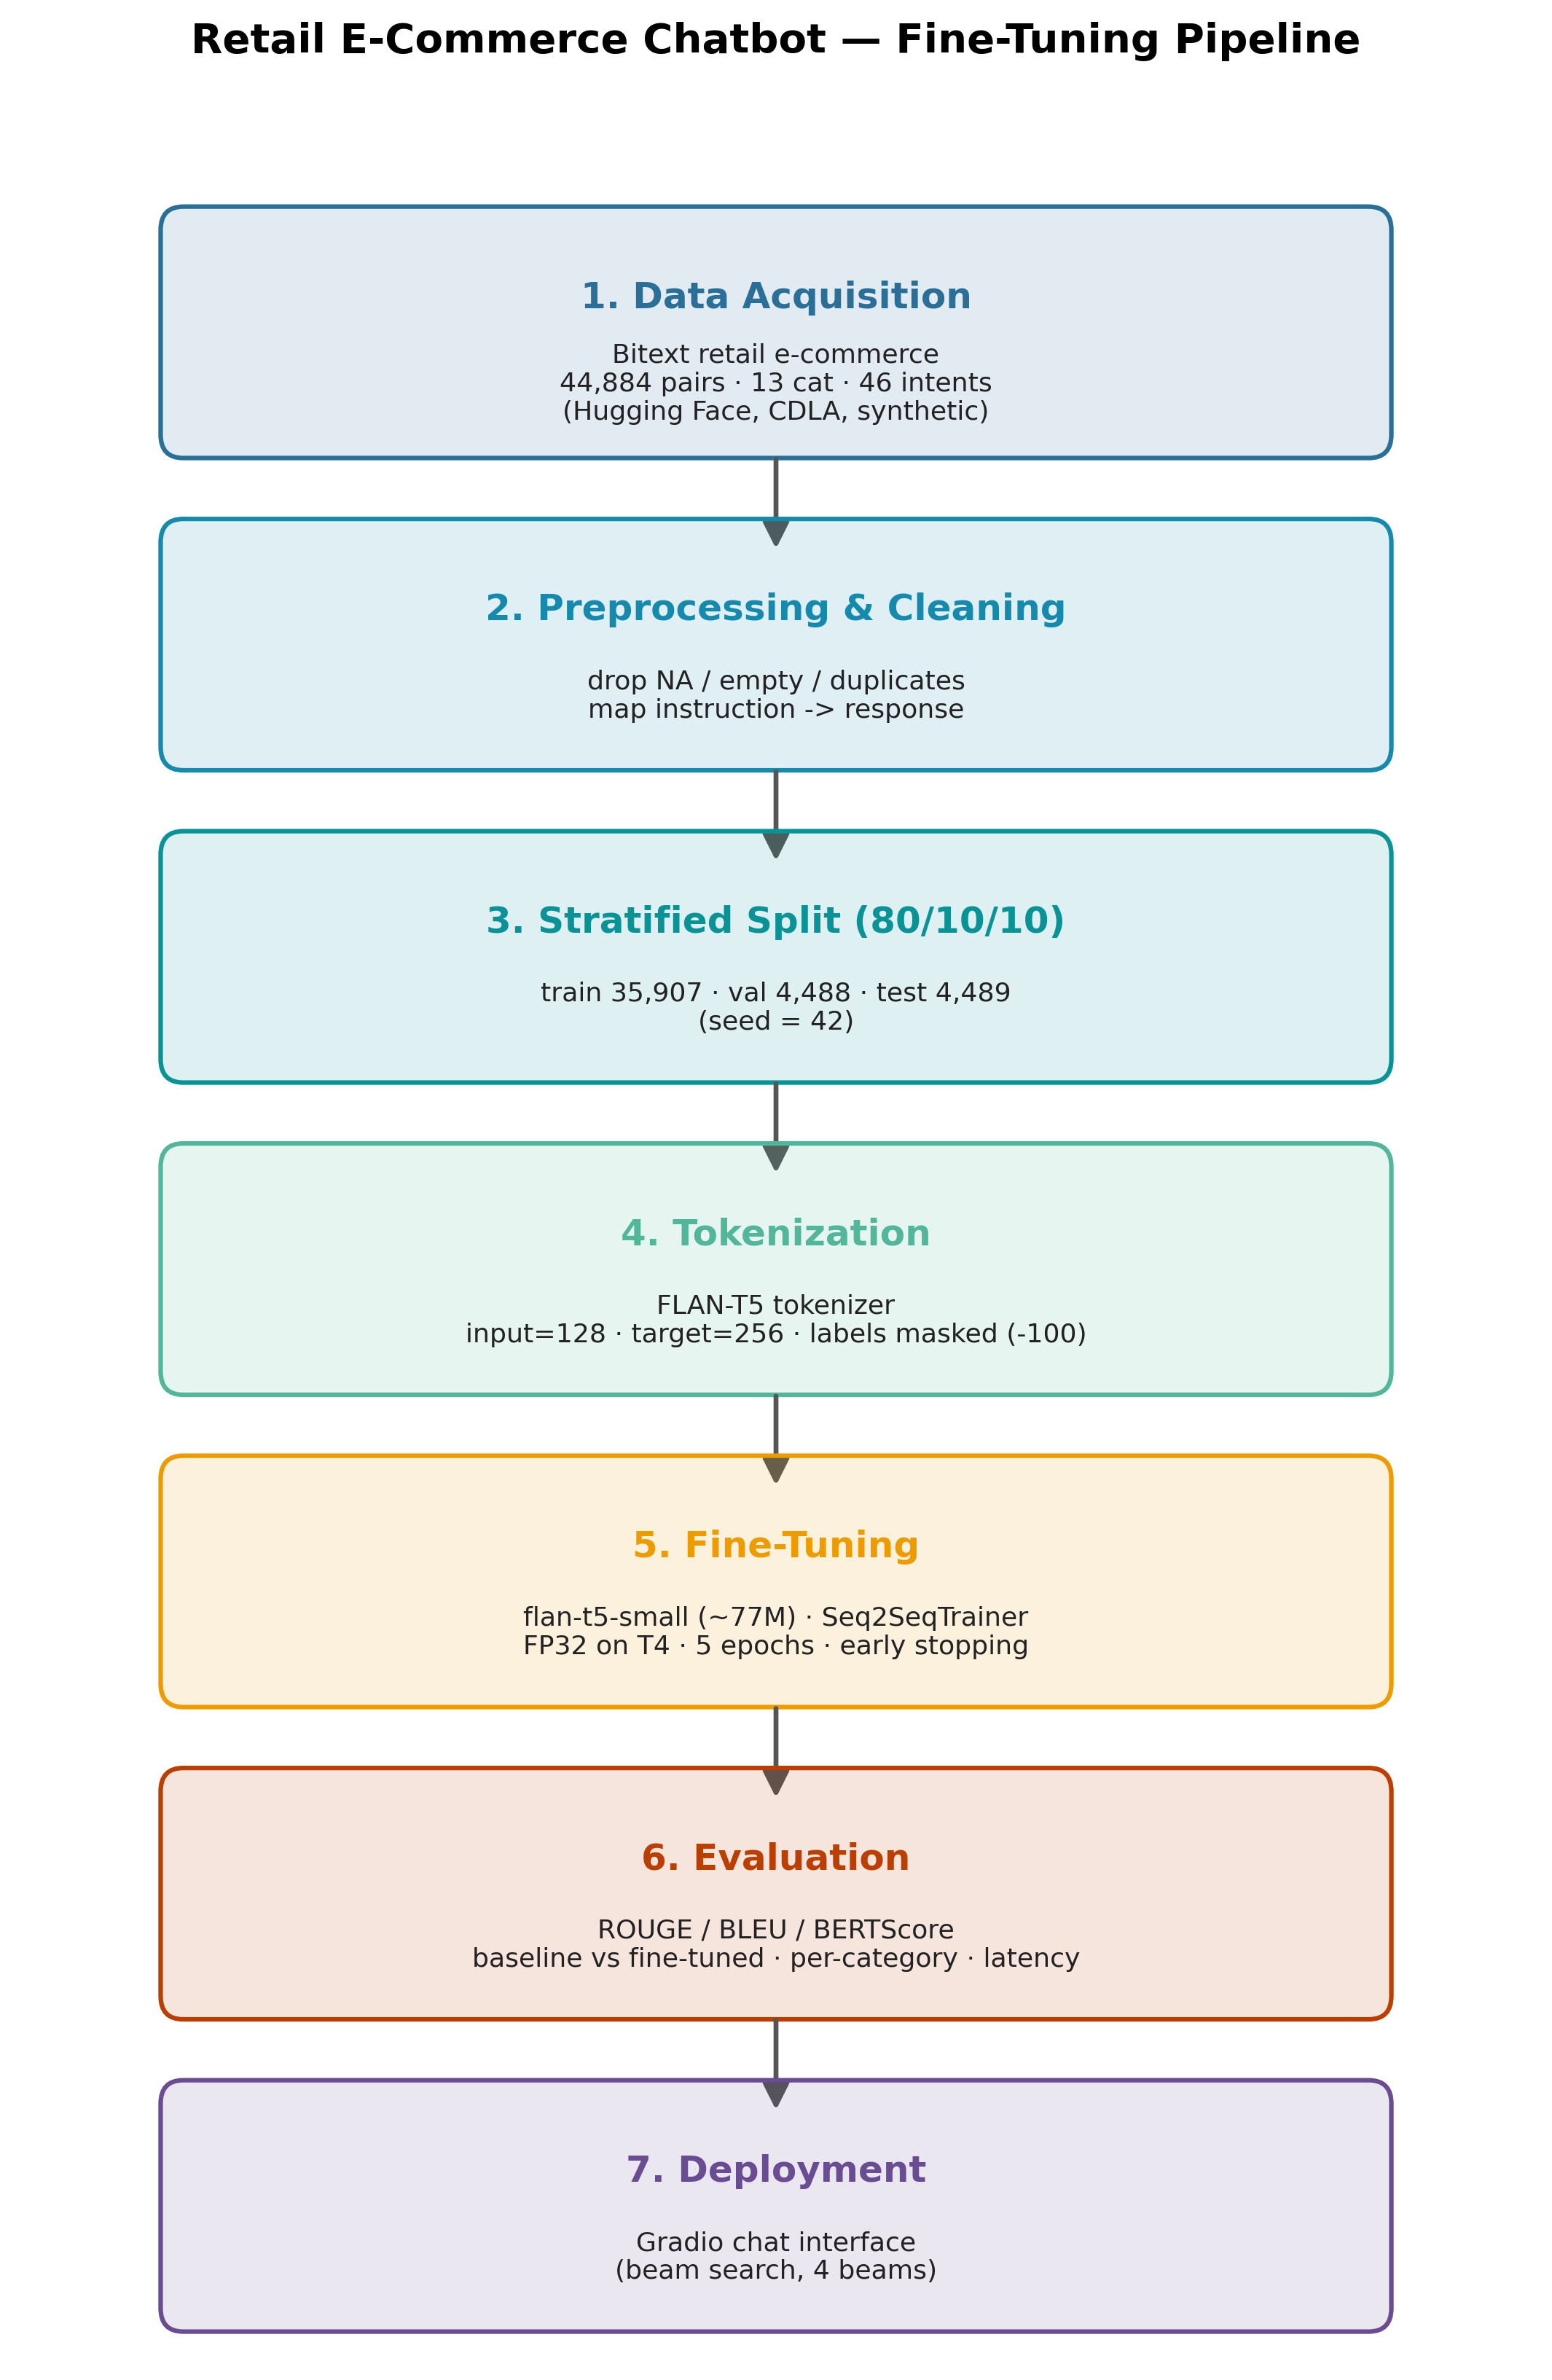
Methodology - Pipeline
• Fine-tuning only (no RAG).
• flan-t5-small (~77M params).
• FP32 on Colab T4 (FP16 NaNs; no bf16).
• 5 epochs, early stopping, seed 42.
• Beam search (4 beams) at inference.

Slide 6
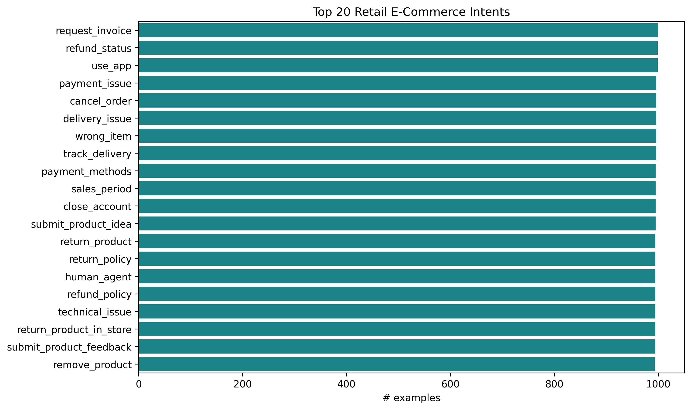
Dataset & EDA
• Bitext retail e-commerce (HF, CDLA, synthetic - no PII).
• 44,884 instruction-response pairs.
• 13 categories, 46 intents.
• Split 35,907 / 4,488 / 4,489 (stratified).
• Token lengths -> input 128 / target 256.

Slide 7
Fine-Tuning Setup
• AdamW, learning rate 3e-4, weight decay 0.01, 500-step linear warmup.
• Batch 8 x grad-accum 2 = effective 16.
• Labels padded with -100 so loss ignores padding.
• Seq2SeqTrainer; best checkpoint by validation loss.
• Up to 5 epochs - within the 25-epoch budget.

Slide 8
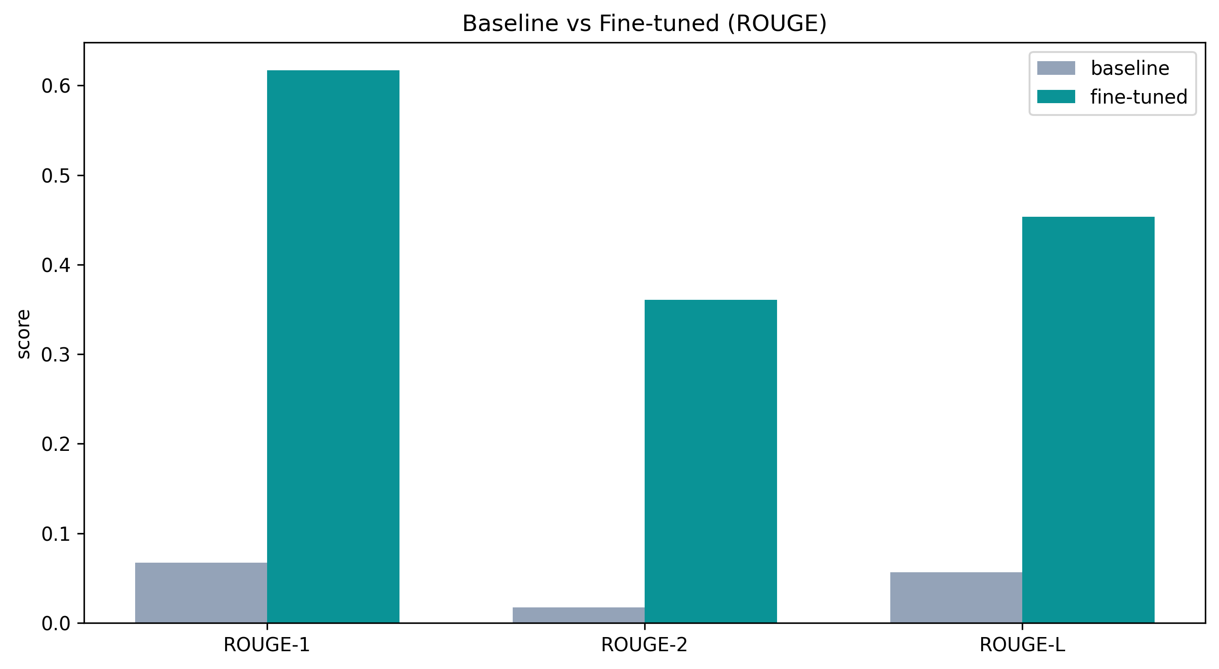
Results - Baseline vs Fine-Tuned
• ROUGE-L: 0.057 -> 0.453 (~8x).
• BLEU: 0.0 -> 29.27.
• BERTScore-F1: 0.818 -> 0.909.
• Avg response: 7 -> 133 words.

Slide 9
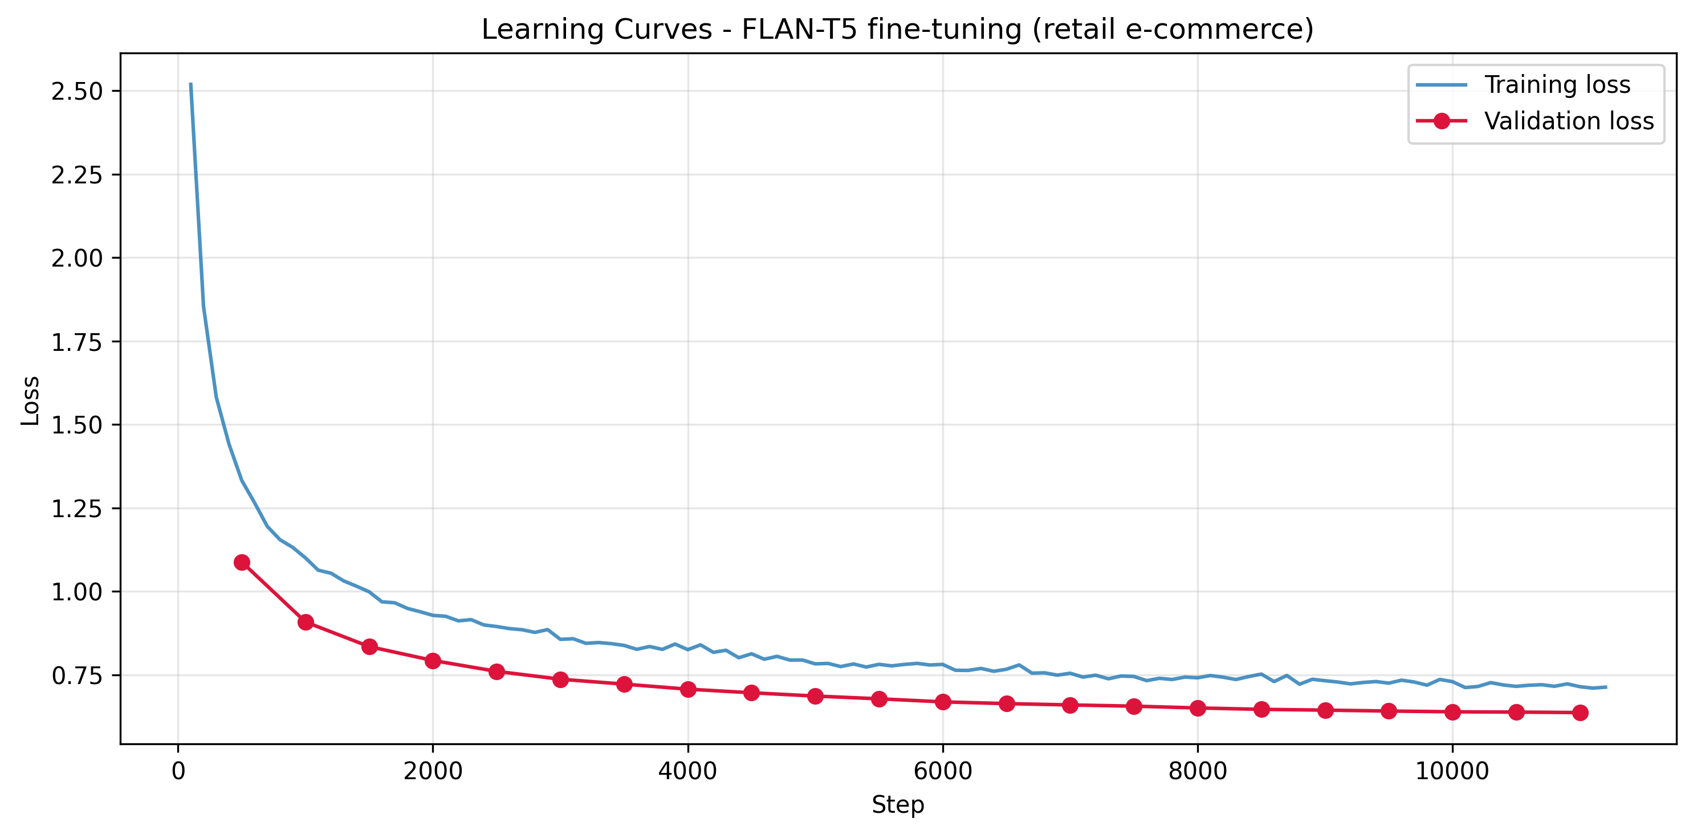
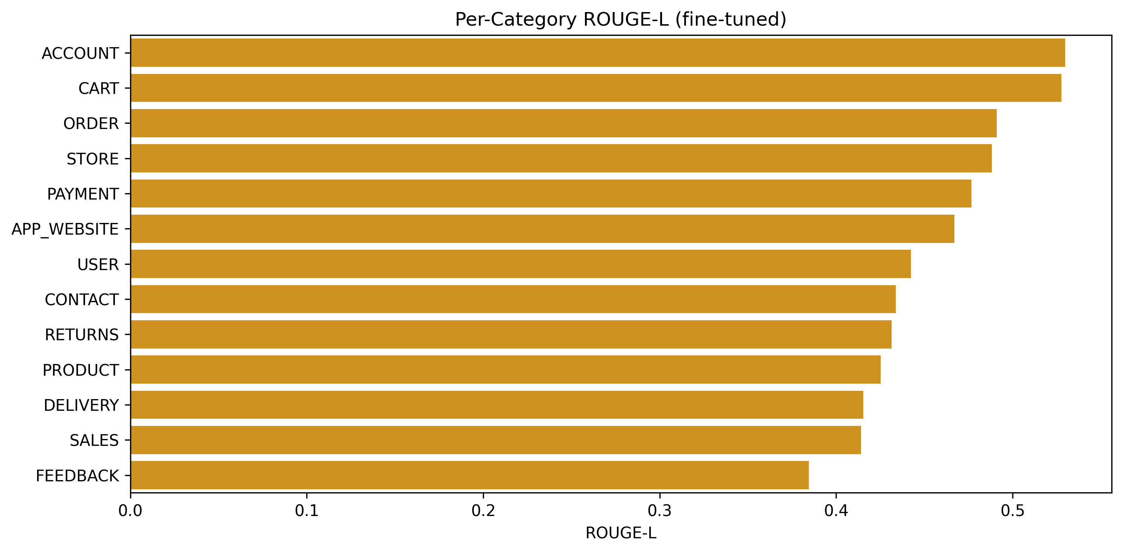
Results - Convergence & Per-Category

Slide 10
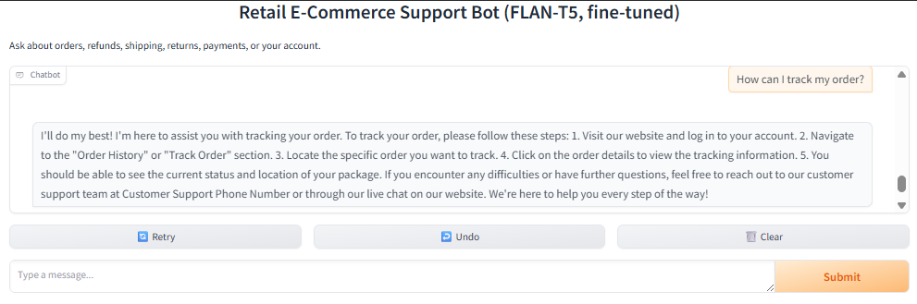
Demonstration & Qualitative Behaviour
• Gradio chat interface served from the notebook.
• In-domain: structured, step-by-step answers.
• Baseline gave useless one-liners.
• Ambiguous words (e.g. 'refund') -> inferred intent.
• Out-of-domain -> answered in support style (over-generalisation).

Slide 11
Discussion & Limitations
• Domain adaptation - not scale - was the limiting factor.
• Practical: cheap to reproduce/retrain; automate high-volume intents first.
• Limitation: no out-of-scope detection -> needs intent filter + human fallback.
• Limitation: synthetic data; automatic metrics approximate human judgement.

Slide 12
Conclusion & Future Work
• Compact, free-tier-trainable model handles routine retail support well (8x ROUGE-L gain).
• Contribution: transparent, reproducible blueprint for low-resource domain chatbots.
• Future: out-of-scope detection + human handoff; real logs + human eval;
• larger-model comparison (flan-t5-base); multi-turn; multilingual.

Slide 13
Key References
• Vaswani et al. (2017) - Attention Is All You Need.
• Raffel et al. (2020) - T5.
• Chung et al. (2022) - FLAN.
• Nandi et al. (2024); Khennouche et al. (2023) - customer-service chatbots.
• Bitext Retail E-Commerce dataset (HF, CDLA-Sharing-1.0).

